Slide 1

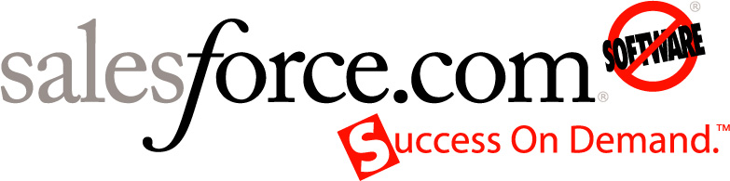
Welcome To The Business Cloud
Kendall Collins
SVP, Force.com

Slide 2
Safe Harbor
Safe harbor statement under the Private Securities Litigation Reform Act of 1995: This presentation may contain forward-looking statements that involve risks, uncertainties, and assumptions. If any such uncertainties materialize or if any of the assumptions proves incorrect, the results of salesforce.com, inc. could differ materially from the results expressed or implied by the forward-looking statements we make. All statements other than statements of historical fact could be deemed forward-looking, including any projections of subscriber growth, earnings, revenues, or other financial items and any statements regarding strategies or plans of management for future operations, statements of belief, any statements concerning new, planned, or upgraded services or technology developments and customer contracts or use of our services.
The risks and uncertainties referred to above include – but are not limited to – risks associated with developing and delivering new functionality for our service, our new business model, our past operating losses, possible fluctuations in our operating results and rate of growth, interruptions or delays in our Web hosting, breach of our security measures, the immature market in which we operate, our relatively limited operating history, our ability to expand, retain, and motivate our employees and manage our growth, new releases of our service and successful customer deployment, our limited history reselling non-salesforce.com products, and utilization and selling to larger enterprise customers. Further information on potential factors that could affect the financial results of salesforce.com, inc. is included in our annual report on Form 10-K filed and our quarterly report for the most recent fiscal quarter ended July 31, 2008. These documents are available on the SEC Filings section of the Investor Information section of our Web site.
Any unreleased services or features referenced in this or other press releases or public statements are not currently available and may not be delivered on time or at all. Customers who purchase our services should make the purchase decisions based upon features that are currently available. Salesforce.com, inc. assumes no obligation and does not intend to update these forward-looking statements.

Slide 3
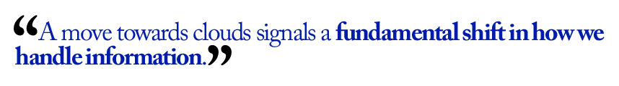

“Cloud Computing” – One Year of Buzz or the Future?

Slide 4

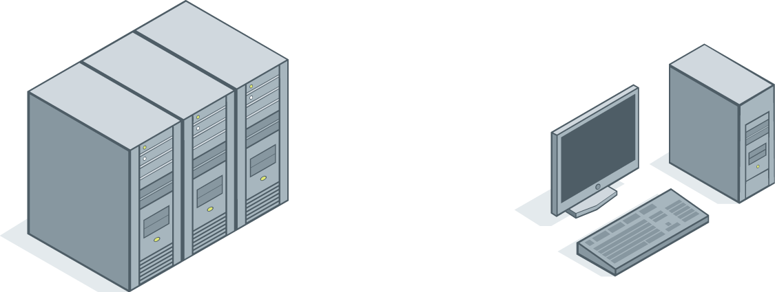





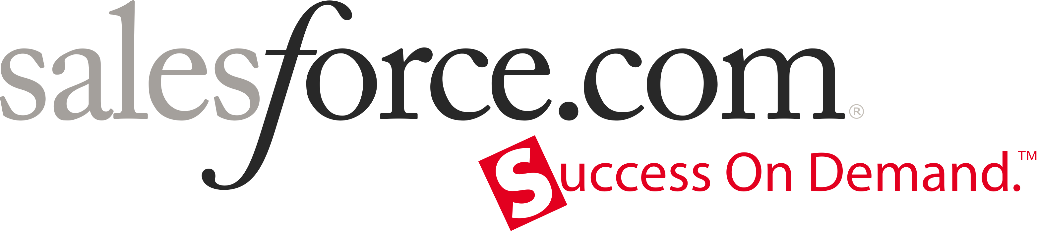
Salesforce.com’s Mission:
Cloud Computing Driver, Catalyst & Evangelist
Mainframe
Client/Server
Software as a Service
Mid 20th
Century Platforms
Late 20th
Century Platforms
21st
Century Platforms
Notes:
I’m here to tell you about the next major shift in computing paradigms called Cloud computing. Cloud computing is a relatively simple concept but it has a profound impact on the ability of IT to deliver more applications, better applications, faster, easier and at a lower cost.
Cloud computing simply means that infinite computing resouare available, somewhere on the Internet, that you can tap into to, to build and run your applications instead of having to buy, install, configure and manage a finite set of resources yourself. I want to emphasize this point- if you want to build and run an application, you don’t need to buy, install, configure and manage things like servers, storage, operating systems, application servers, databases, Web servers, security, management and other products. Nor do you need to provide the facilities to house them or the electricity to power them. Also, the people who used to managed these systems can focus on the higher value, more strategic functions of IT.rces
Over the last ten years we’ve seen many business applications move from on-premise systems to the Cloud. Salesforce CRM applications led the way while on-premise products like Siebel fell into obscurity. Many Cloud based applications from many vendors are now available. Sometimes you hear people call this Software as a Service, or On-Demand applications.
While the shift to Cloud based applications has been interesting, it’s actually a very hard thing to do so the number of applications available in the Cloud has been limited to those who could invest hundreds of millions of dollars in the infrastructure, people and technology to make this model work.
The next major shift, known as Platform as a Service, has been to open up these platforms and make them available to ISVs and IT departments to build and run their own applications in the Cloud.
Just like we saw on-premise business applications like Siebel and Peoplesoft replaced by Cloud based applications like those from salesforce.com we are now seeing application development platforms move from on-premise platforms like Microsoft .NET and Websphere to cloud computing platfomrs from Salesforce, Google, Amazon and others.

Slide 5
Cloud Computing Economics Cannot Be Ignored
Single Tenant Efficiency
Utilized
20%
Utilized
35%
Business
30%
Wasted
80%
Wasted
65%
Upkeep
70%
Server Capacity
Storage Capacity
Labor
Source: Nick Carr, “The Big Switch”
Notes:
This data is from Nick Carr’s, Big Switch. Professor at MIT. Whether you believe this data, Gartner’s, or your own- the reality is that all data points roughly in the same direction.
There is a tremendous amount of capacity that is wasted. We’ve all seen the value of virtualization of hardware and software infrastructure. This is Jeff Bezos’ fundamental pitch which is they had built all this capacity and infrastructure, but it was underutilized, etc.
The economics of the cloud can’t be ignored. IT departments, ISV’s, and entrepreneur’s are all taking advantage of this and it is altering the economics for delivering applications, but also the entire landscape of what’s possible, where it comes from, and ultimately the quality and trust of these applications.

Slide 6
Cloud Computing Makes No Compromise
Mainframe Platforms
Client / Server
& App Server Platforms
Cloud Computing
Speed & Flexibility
Speed & Flexibility
or
and
Control & Manageability
Control & Manageability
Notes:
Why are IT organizations moving to this new model? Lets look back for a minute to the last time platforms shifted.
IT organizations have always struggled to balance the desire to maintain centralized control of systems so they can be managed effectively with the pressure for IT to have the speed and flexibility to meet the ever changing requirements of business users
Mainframes were great in terms of giving IT centralized control but they were very inflexible and application development and deliver was very slow. This resulted in highly manageable system but a slow pace of innovation.
With the move to client server and app server platforms, IT organizations were able to increase their flexibility and speed to deliver but this came at the cost of a loss of central control and governance. In a world where pretty much anyone can have an app server under there desk, its hard for IT to ensure that all applications and systems meet corporate requirements for security, performance and auditability let alone usability and quality.
The reason why IT organizations are so excited about cloud computing platforms is that they offer the best of both worlds. Since, by their nature, they are centralized, cloud platforms feature extremely high levels of control and manageability but because the burden of infrastructure has been removed, II is able to enjoy new levels speed and flexibility.

Slide 7
Cloud Computing is Aligned with IT Success
Client / Server
& App Server Platforms
Cloud Computing
Time to Value in Months
Fragmented Security & Compliance
Painful, Risky Upgrades and Updates
Complex Infrastructure
Time to Value in Weeks
Central Security & Compliance
Automatic Upgrades
No Infrastructure
Notes:
The shift to cloud platforms addresses many of the challenges that IT organizations have faced with current platforms.
Slow time to value, fragmented security & compliance, painful, risky upgrades and updates, too much resources allocated to managing infrastructure.
In this new model, you can go from idea to application to real business value in weeks instead of months.
… You can ensure the highest level of security, control and compliance exists for EVERY application
… You can remove the entire concept of spending time and resources on software upgrades & updates
Simply put, by removing pain, cost and risk of managing infrastructure, you can free up more of your IT organization to work on new projects vs. simply keeping the lights on. To our customers, this focus on Innovation, Not infrastructure is transforming the very nature of IT.

Slide 8
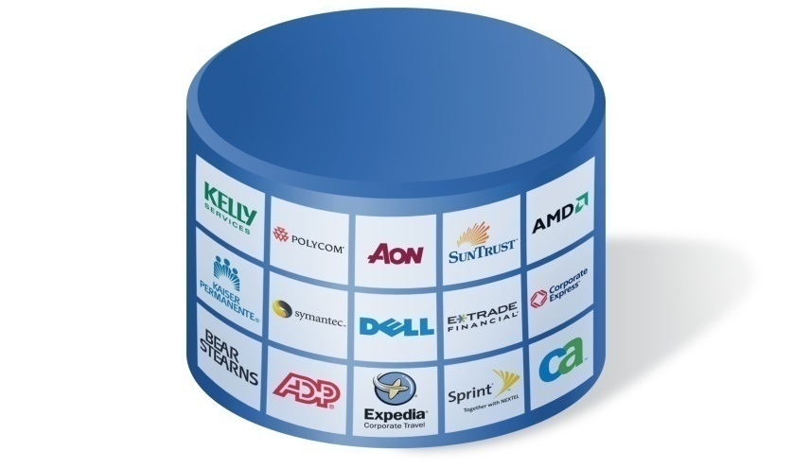




Cloud Computing: Technology Model & Business Model
Multi-tenant
Subscription
Faster Vendor Innovation
Economies of Scale
Scalability
Automatic Upgrades
Notes:
While Cloud computing is broad in definition – most people would agree it’s both a new technology model and a new business model.
On the technology side, there is a broad spectrum - I have heard everything from the Corio/USIX model, to virtualization, to infrastructure services as the model. Based on our success and experience in delivering CRM, we believe that multi-tenancy is a critical element. This is effectively a single software and hardware stack that is shared by multiple tenants – it may be replicated horizontally of course like our pod structure, but it is still an identical and integrated stack for every tenant that is shared. It is the hardest to deliver and puts the most burden on the vendor, while freeing up the tenants to focus on innovation.
On the business model – we have seen everything from CPU hour, storage, transaction or API pricing, to subscription. Subscription model has fundamentally aligned us with a customer’s long term success, so it has been our choice.

Slide 9

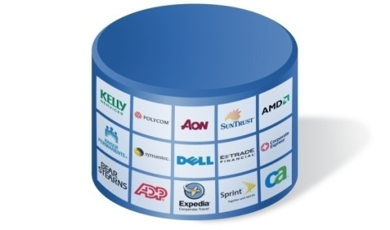
Multi-Tenancy Makes Cloud Computing Possible
Single-Tenant
(On-Premise or Hosted)
Multi-Tenant
One Company
Many App Stacks
Many Companies
One Shared Stack
App 2
App 2
App 1
App 3
App 1
App 3
App Server
App Server
Database
App Server
Database
OS
Database
OS
Server
OS
Server
Storage
Server
Storage
Network
Storage
Network
Network
Buy, Install, Build, Tune, Upgrade
Innovation. Not Infrastructure
Notes:
How are cloud computing platforms able to deliver a faster, easier and lower risk model to IT? It’s a new architecture called multi-tenancy that makes this possible.
The last generation of applications were single tenant, meaning that each application had it’s own set of dedicated hardware and software resources such as CPUs, storage, memory an operating system, an application server, a database, etc.
There are many challenges with single tenancy. For example, there are dozens of hardware and software products to evaluate, buy, install, configure and manage. It’s hard to find and retain the necessary skill sets needed to use all of these products. Configuration and performance tuning can be hard to do. CPU and storage are often underutilized. Vendors can’t replicate your environment when there’s a problem. Plus, software upgrades and patches can often break your customization and integrations.
In the end, each incremental application adds incremental expense, complexity and risk to your IT portfolio. According to Gartner, many IT departments spend 80% of their budget just keeping the infrastructure up and running and only 20% adding new business value.
Multi-tenancy is a new architecture that makes it possible for all applications from all organizations to run on common physical infrastructure. This is a key technology enabler for dynamically sharing resources across applications, doing security monitoring, disaster recovery and general systems maintenance that benefits all applications and users simultaneously.
An example of single vs. multi-tenant applications are Microsoft Exchange vs. Gmail. With Microsoft Exchange you need dedicated servers, storage, a variety of software products and people to run it. With Gmail, many organization and millions of users can customize the application to their particular needs without needing a separate set of Gmail servers and Gmail software for themselves. Gmail is one, large shared system that can accommodate everyone’s needs.

Slide 10

Force.com Cloud Computing for the Enterprise
Salesforce Apps
Customize, integrate and manage
800+ ISV Apps
Browse, test drive & install from our partners
69,000 Custom Apps
Run your business processes on our service
Salesforce Apps
ISV
Apps
Custom
Apps
26+ major upgrades
Customizations and apps run on the latest release automatically

Slide 11




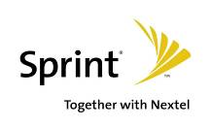













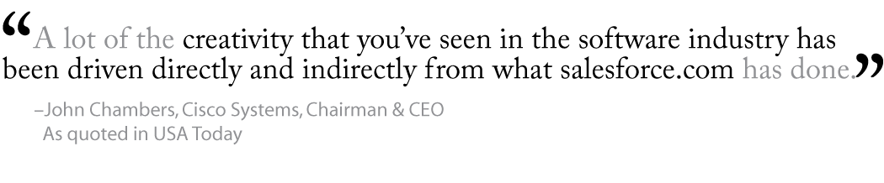
Force.com Cloud Relied Upon By Large Enterprises
Enterprise Std
~65,000
~30,000
~30,000
~25,000
~21,000
~ 12,000
~6,300
~5,800
~5,500
~5,000
~4,000
~4,000
~3,200
~3,000
~2,900
~2,600
~2,500
~2,000
Number of Subscribers
Notes:
The force.com platform has become one of the most reliable and trusted in the industry. Not just for CRM but far beyond it. In fact our two largest customers now are really platform customers – although we are CRM standards there as well. We have an enterprise license agreement with Dell for essentially unlimited business applications that are built and delivered on our platform, as well as an easy path to consume ISV apps that are built on our platform.

Slide 12

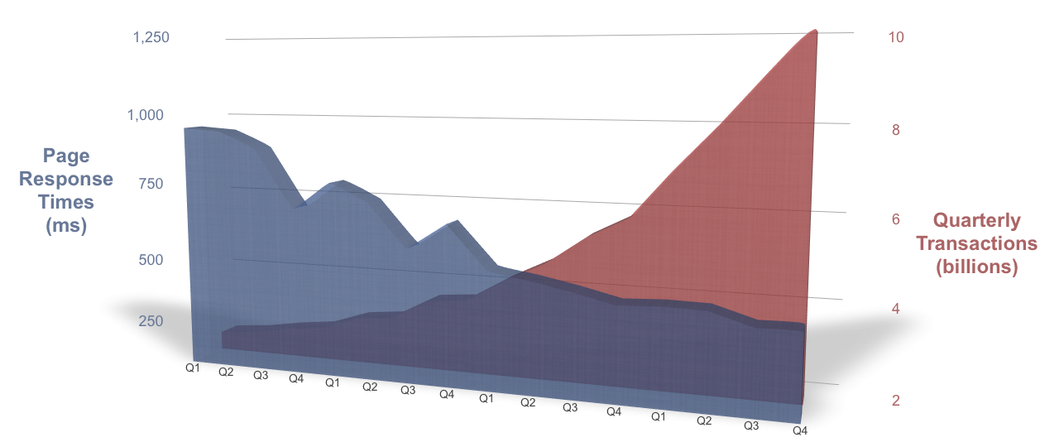
Cloud Computing Scalability and Performance
Delivering 150 Million Transactions Daily
Notes:
At the heart of the force.com platform is our global, secure, trusted infrastructure. Over 43,600 customers rely on our service to power their end users around the world, every day. While the use of our service has grown tremendously, to over 150 million transactions a day, we have also been able to deliver these transactions a higher than ever levels of performance typically less than ¼ of a second for each transaction.
Additionally, we provide an industry-leading level of transparency into our infrastructure operations through our trust site. We have a public web site, trust.salesforce.com that publishes real-time information on the performance of our service. This web site lists the current status of our service, details upgrade and maintenance schedules and provides a two week running history of server performance and availability.
The fact that any disruption in the quality of our service is immediately displayed on a site that is public to the world instills our organization with a culture of accountability. We fundamentally believe that transparency drives accountability which drives the right set of organizational behavior that is necessary for us to continue our leadership in delivering the world's most reliable and scalable cloud computing platform.

Slide 13

Force.com Recognized as a Visionary Platform
“
Force.com is well-ahead of all major players in SaaS and aPaaS markets, as well as in mind share, forcing most competitors to catch up.
Visionary:
App Server
”
April 24, 2008
Enterprise Application Server Magic Quadrant
Notes:
In addition to our customers, the force.com platform has also been validate by the analyst community. Gartner recently recognized force.com as a visionary platform in their latest enterprise application server magic quadrant.

Slide 14
First Cloud Computing Company to Exceed $1 Billion Annual Run Rate
263
248
217
192
177
162
144
Quarterly Revenue ($M)
130
118
105
83
91
64
72
55
41
46
35
Q1 Q2 Q3 Q4 Q1 Q2 Q3 Q4 Q1 Q2 Q3 Q4 Q1 Q2 Q3 Q4 Q1 Q2
FY2005
FY2006
FY2007
FY2008
FY2009
Revenue though fiscal quarter ended 7/31/08

Slide 15

Our Vision: The End of Software

Slide 16


Entering the Second Decade of No Software
salesforce.com’s first decade:
salesforce.com’s second decade:
Software as a Service
+ Platform as a Service
= Cloud Computing
Software as a Service
1999
2009
2019

Slide 17
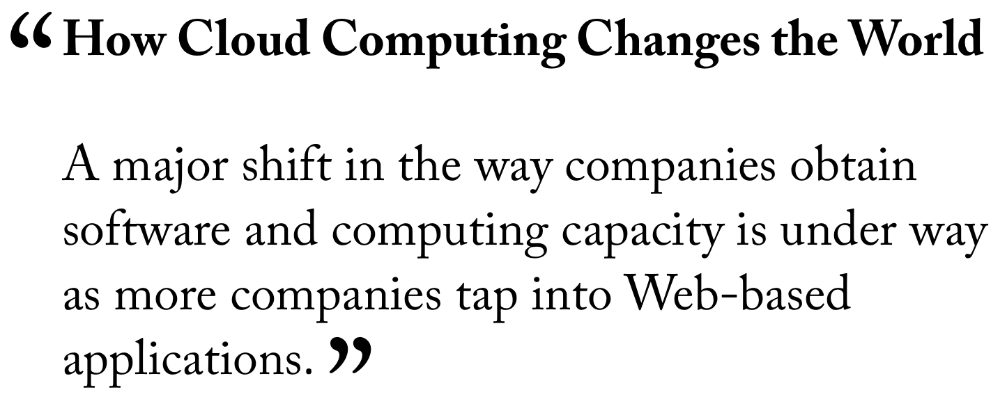

Now the Market has Reached a Tipping Point
August 4, 2008

Slide 18
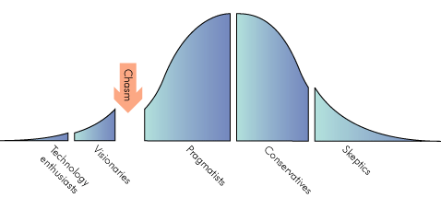
Adoption of Cloud Computing in the Enterprise
Collaboration
CRM Apps
ISV App-Dev Platform
Corporate IT App Dev
ERP Apps
Visionaries
Pragmatists
Skeptics
Technology Enthusiasts
Conservatives

Slide 19
Demand for Cloud Apps Doubling in Most Categories
2008
2010
“SaaS has been steadily moving from the edges to the core, and in another few years will increasingly bring ERP, Supply Chain and GRC solutions to the enterprise.”
Source: Saugatuck Technology – SaaS Adoption Research 2008 (n=418) - % of companies deploying

Slide 20
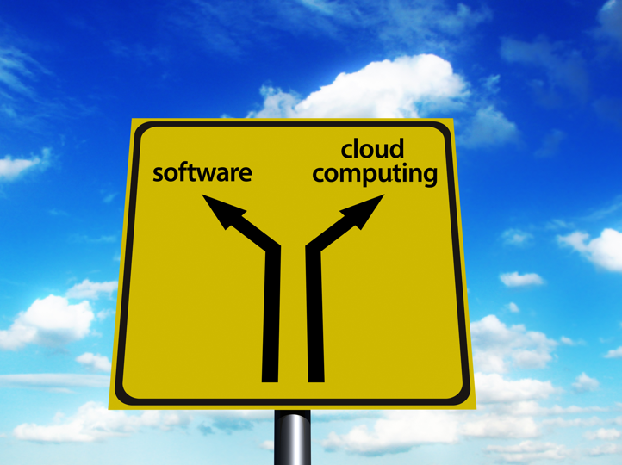




It’s Time For Every Software Developer To Ask:
“Which Path Will I Choose?”

Slide 21
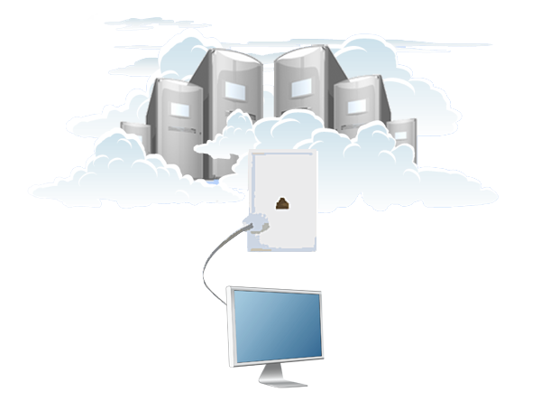

Cloud Computing Empowers Every Developer, Globally
Plug into a Utility Service
Access Unlimited Computing Power
Infrastructure for Any Idea
Leverage The Work Of Others
Notes:
v

Slide 22
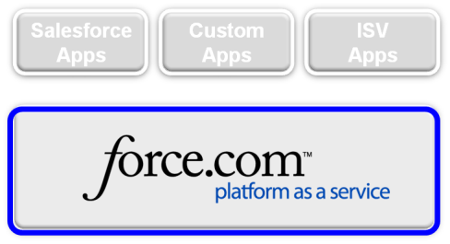




Faster, Easier and Lower Risk
Infrastructure
Services
Operations
Services
Application
Services
YOU
get to focus on innovation
Network
Storage
Operating System
Database
App Server
Web Server
Data Center
Authentication
Availability
Monitoring
Patch Mgmt
Upgrades
Backup
NOC
Security
Sharing
Integration
Customization
Web Services
API
Multi-Language
Build your data model
Build your business logic
Build your user interface
Notes:
Force.com faster, easier and lower risk than traditional single-tenant platforms.
With force.com you can focus on innovation, not infrastructure. We believe that developers should be able to focus on building their applications vs. worrying about the hardware and software infrastructure required to run these applications. This approach allows IT organizations to build apps faster, with less resources and with no infrastructure impact.
The reason this is possible is because force.com provides all of the infrastructure, application and operational service required to build and run enterprise-class business applications.
There is no data center to manage … no hardware, storage or network to set up .. No backups or disaster recovery. We take care of all of this for you
We accelerate the development and deployment of your apps by proving many of the common application services or building blocks of enterprise apps as a service so you don’t have to re-build these for every app.
Additionally from an operational perspective, we handle all the performance tuning, software patches and updates, backup and disaster recovery. All of this comes as a service and requires zero customer effort or attention.
What all this means for you is that you can focus on your unique app vs. all of the hardware, software and operations required to run it. You focus on what’s unique: the data model, business logic and user interface of your app and we handle the rest.

Slide 23




Force.com Offers a Better Model for Application Development
Comparison to Build Custom Brand Promotions Application
Development Time | 100 Hours | 4,000 Hours
Time to Deploy | Instant | 4 Weeks
No Hardware and Software
No Maintenance Required
No Extra Development Required
IT Administration Console
Analytics
Internationalization
Authentication & Security Model
Mobile Device Deployment
Compliance Audit Trail
End User Usability Rating
Source: Fortune 500 Media Corporation Evaluation
Notes:
What’s the impact of force.com and platform as a service on IT success?
One of our customers did a head to head evaluation of force.com vs. Microsoft .NET to find out. As a test they took a relatively straightforward app that tracked the licensing of brand assets including a worldwide workflow approval process and built this app on both platforms.
What they found was that building apps on force.com platform a) was dramatically faster, b) allowed their developers to focus their time on higher value activities and c) delivered a more functional app that was judged to be much easier to use.
The .NET application too 4,000 hours to develop while the force.com application took only 100 hours. The reason for this accelerated timeline was all of the hardware and software infrastructure that the force.com development team didn’t have to worry about. While the .Net team had to hand functionality like build an IT administration console, internationalization, authentication and audit history tracking, all of this came “for free” to the force.com developers. They simply had to configure these pre-built application services. Additionally, the force.com developers were able to add phase 2 application functionality like mobile device deployment and analytics which the .NET team did not have time to address.
Plus, the force.com application was able to leverage the built-in consumer web usability of our platform to deliver an app that end users scored more than twice as high from a usability perspective.

Slide 24
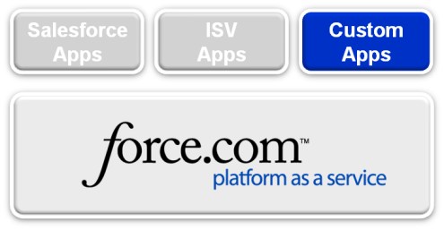
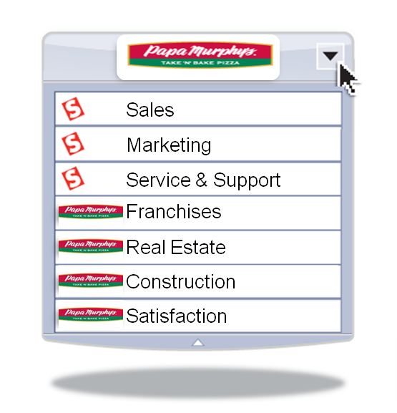

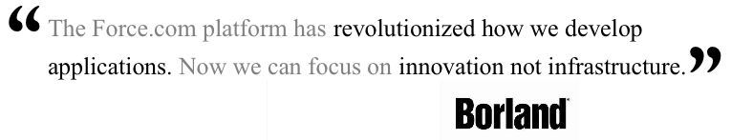

Force.com is Faster
Delivering four franchise management apps in two months
Force.com is the only platform that let us deploy to 900 stores instantly, and without increasing their burden on IT.
- Joe Smith
Director of App Development
Papa Murphy's
Notes:
Papa Murphy’s needed to track and manage over 900 franchises across the country. The business was rapidly growing and finding locations for new franchise construction, monitoring franchise performance and measuring franchise customers’ satisfaction was critical.
The project success factors including limited infrastructure at each of the separately owned franchises, full mobile access for users that spent a majority of their time on the road, central management and administration, and rapid time to value.
After careful evaluation of all other options, Papa Murphy’s decided on the Force.com platform. They built several custom applications to track the franchise locations, new construction sites, and customer satisfaction and marketing support for each franchise. The result is a development platform that can grow with their needs, aggregates all data into easily understandable reports and graphs, and can be deployed instantly via browsers, mobile devices, and new franchise locations.

Slide 25

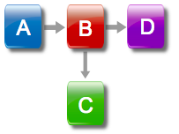



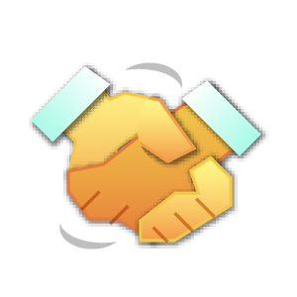



Force.com Development Model: Platform as a Service
Clicks, Components, Code
Multi-Device
Workflow
Customization
Integration
Reporting & Analytics
Sharing
Search
Multi-Language
Data Center
Multi-Currency
You Don’t Have to Reinvent The Wheel
Notes:
You can build new applications or customize existing applications through a combination of point and click configuration of our application services or by running your code on our service.
Lets take a minute to drill into some of these application services components. Force.com comes with many of the building blocks that make up enterprise business apps. All of these components are pre-built for you. You configure these to fit your specific applications vs. building this functionality yourself from the ground up or engaging in a costly, time consuming integration process with multiple third party components.
We provide a database so you can build any data model. Web services integration is hard-wired into all of your apps. Everything you build is instantly accessible through our web services API the minute its built and deployed
Use our workflow engine to create sophisticated workflows and approval processes without writing a single line of code
Use our page layout editor to design user interface page layouts and data entry forms.
Because of the apps built on force.com leverage the platform’s reporting and analytics services, every app is immediately available for end-user reporting without any additional IT development effort.
We provide end user administration services so you don’t have to build an IT-administration console.
Powerful access control and security services allow you to configure any type of application and data access rules into your apps
Plus. All force.com apps are automatically ready for global deployments as multi-currency and multi-currency capabilities come from free with the platform with no additional development effort.

Slide 26
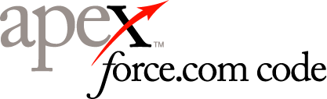

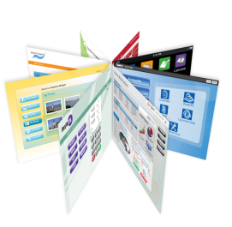
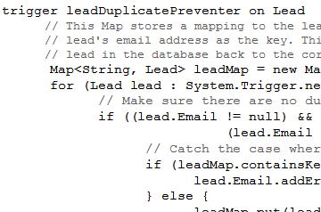
Run Your Code on Our Service
Any Business Logic
Any User Interface
Programmatic Business Logic
Stored Procedures
Triggers
Data Validation
Complex Transactional Logic
Build any user experience
Run on any device
Use standard web technologies: HTML, JavaScript and Flex
Leverage our UI components
Notes:
The force.com platform allows you to run your code on our service for two aspects of application customization or application development: building business logic and designing user interfaces.
The Apex programming language allows you to create highly sophisticated programmatic business logic that runs entirely on our service. You can define triggers to run custom rules before data is inserted, updated or deleted; define virtually any data validation rule, make call-outs to other web services or even build your own new web services that can be consumed by other systems.
Visualforce is a revolutionary technology that lets you design and run any user interface on our service using standard web technologies like HTML, JavaScript and Flex. Plus, we’ve taken all of the UI building blocks of our award-winning CRM applications and packaged them up as UI components that you can leverage for you custom applications. Its never been easier to build new applications that are as easy to use and widely adopted as Salesforce CRM.

Slide 27

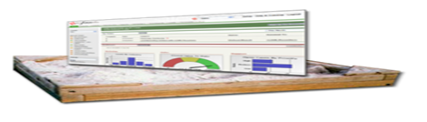
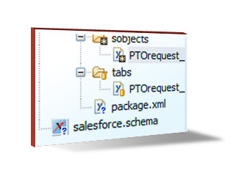
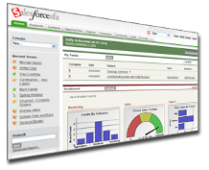
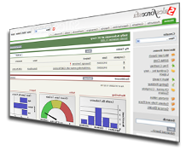

Force.com Tools for Cloud Development
Force.com Sandbox
Eclipse
Force.com IDE
Force.com
Code Share
Metadata API
Easy Access to Code
and Schema
Instantly Set Up Dev Environments
Everything You Need to Build Apps
Easy to Collaborate on Projects
Notes:
Force.com provides a complete set of developer tools for all of your application development and customization needs.
This is all made possible by our metadata APIs which provide programmatic access to the metadata that defines both your custom apps and the customizations your organization has made to packaged applications.
Force.com sandbox allows you to instantly deploy multiple environments to support all of your development, test, staging and training environment requirements.
The Eclipse force.com IDE delivers a full integrated development environment that your developers can use to interact with custom applications and app-customizations at the code-level. Additionally, you use the IDE to manage the process of migrating changes, customizations, integrations and whole applications between your environments. Plus with Force.com code share you can easily integrate with source code control systems and collaborate with teams of developers working on common projects.

Slide 28

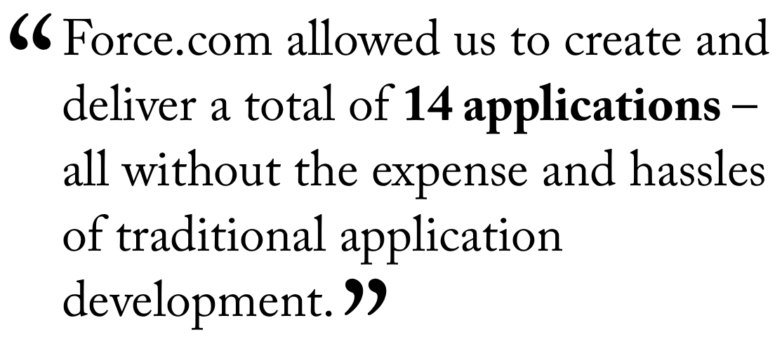

Customers Are Running their Business In The Cloud
Gabrielle Toledano
Customer Hero

Slide 29
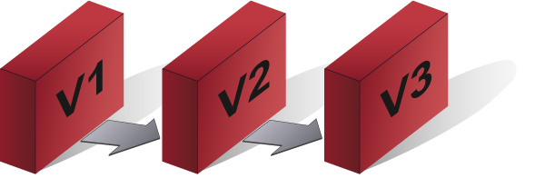





Force.com Apps Benefit from Continuous Cloud Innovation
Seamless Upgrades
Continuous
Innovation
Economies of Scale
Adoption & Usability
Instant
Capacity
Instant Provisioning
Faster
Over Time
More Secure
Over Time

Slide 30
CIO’s Are Managing a Portfolio of Cloud Apps
Salesforce Apps
Customize, integrate and manage
800+ ISV Apps
Browse, test drive & install from our partners
69,000 Custom Apps
Run your business processes on our service
Salesforce Apps
ISV
Apps
Custom
Apps
26+ major upgrades
Customizations and apps run on the latest release automatically

Slide 31






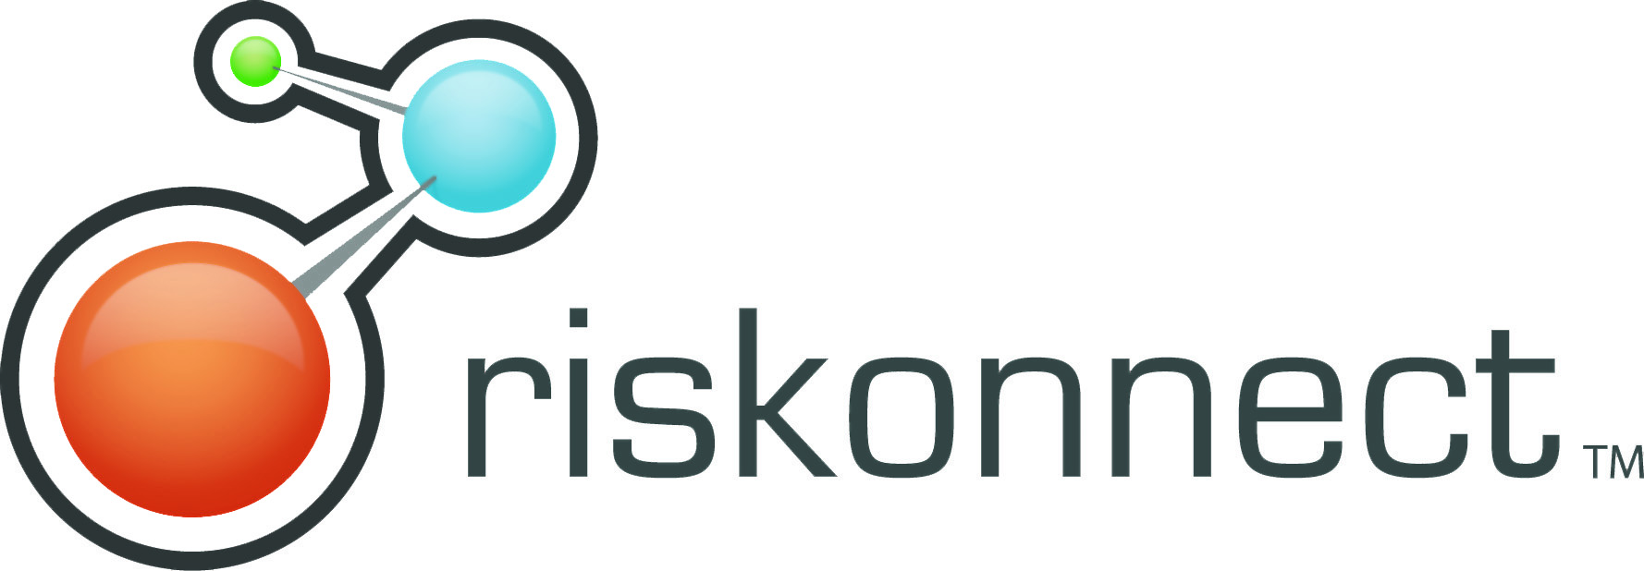
A Tipping Point in Native ISV Apps on Force.com…

Slide 32
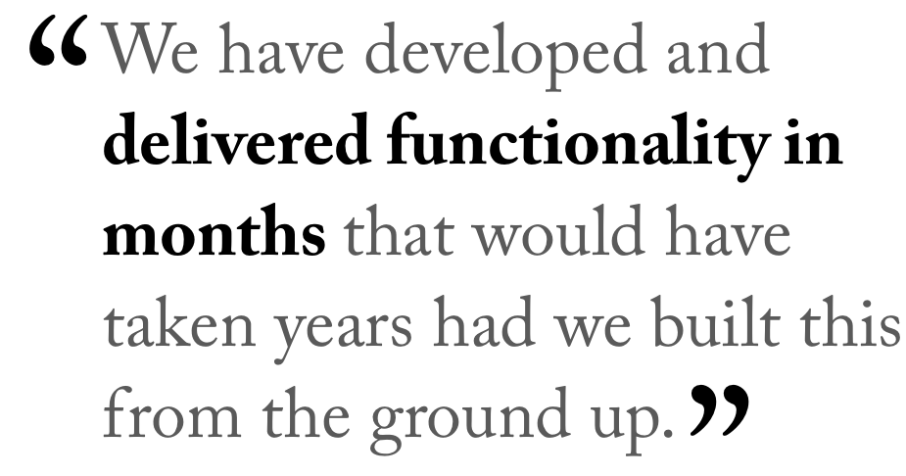

Hundreds of ISVs Building 100% Native on Force.com
Jeremy Roche
CEO
Notes:
One of the most interesting force.com success stories is a company called CODA. CODA is the 2nd largest software company in Europe and has been offering ERP applications for the past 20 years. They began an initiative last year to migrate their client/server software suite to a software as a service model. Instead of spending the vast sums of money and time required to build up a new SaaS platform and infrastructure that would meet the requirements of their highly security conscious customer base, they decided to build their SaaS strategy on Force.com; leveraging our platform and all of our investments instead of building this on their on. This resulted in a tremendous go-to-market advantage as they were able to build a complete general ledger financials application natively on force.com in only 7 months. This is a testament both to the creativity of the engineers at CODA but also to the flexibility of the force.com platform to power any type of sophisticated business application
IKEA, Avis, HSBC, Unilever are customers of Coda

Slide 33
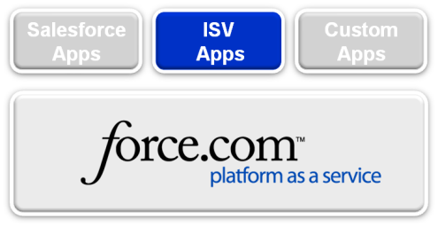







Native ISV Apps From Every Major Category
ERP
Finance & Accounting
Contract & Proposal Management
Vertical CRM for Life Sciences
Productivity & Collaboration Tools
Sales Compensation Management
Human Capital Management
Notes:
We’re seeing tremendous growth in native force.com ISV applications in every business applications category. ERP and Finance apps from companies like CODA and Datasul are extending the success of the software as a service model to back office business processes. We’re seeing new applications in sales, contract management, HR and even industry-specific applications like Verticals on-demand targeting the pharmaceutical industry.

Slide 34

Cowen & Company
Daniel Flax
Chief Information Officer

Slide 35
Cowen and Company
Financial institution founded in 1918; acquired in 1998 by Société Général; spun out in 2006 as a wholly independent company
Publically traded NASDAQ: COWN
Major lines of business:
  Investment Banking
  Equity Research
  Equity Sales and Trading
  Traditional and Alternative Asset Management
Notes:
Cowen’s a great place. Blah blah blah.

Slide 36

Cowen and Company
550 Employees
Headquarters in New York City
Offices in:
  Boston
  Chicago
  Cleveland
  Dallas
  Atlanta
  San Francisco
  London
  Geneva
  Hong Kong
  Shanghai
  Beijing
Notes:
Cowen is a world wide enterprise, with all of the needs that that entails. (time zones, latencies, etc)
I’ve been at Cowen for a little over a year. Prior to Cowen, I was responsible for Trading Systems at the New York Stock Exchange.

Slide 37

Cowen IT Strategy
“Cowen's IT Strategy is to outsource components that are commodity in nature and focus Cowen personnel on areas that can provide distinct business value and competitive advantage.”
Notes:
When I had been on the job at Cowen for about 4 months, my boss asked me to articulate Cowen’s IT Strategy or Philosophy (so that he could tell our Board of Directors).
This is what I came up with.

Slide 38

Cowen IT Themes
Mobility
Open Source
As a Service
Notes:
Specifically, when thinking about where Cowen could add business value vs. where it would be commodity in nature, I came up with three themes that we need to think of for every project. Our goal is always employ at least two of them.
Explain each of the different themes and why it’s important.

Slide 39
Salesforce.com @ Cowen
Initial implmentaion of SalesForce CRM in 2006
Solution includes Tier1CRM (fka StraightThrough)
Tier1CRM solution provides industry specific Capital Markets solution
Rolled out to Equity Sales and Trading, Research and other areas
Have added Asset Management groups on w/o the Tier1CRM solution
Notes:
Basic history of SFDC at Cowen. Replaced a legacy in-house developed system that couldn’t scale and didn’t provide all of the business functionality that was desired.
The Tier1CRM integration was key. It was this mashup that provided the extra functionality above and beyond the basic SalesForce capabilities that Cowen needs.

Slide 40
Cowen Research Portal
Cowen’s Research group distributes their research product via a number of methods, a Cowen branded website being one
Legacy vendor of Research Distribution Portal getting out of that space, booting us off their platform
We reviewed the build vs. buy decision and decide to build (Open Source & Mobility)
Notes:
This is the first project that came up where we employed the three themes when we looked for a solution. Initially chose to build ourselves, focusing on Open Source and Mobility as the two dominant themes.

Slide 41

Research Portal on Force.com
Evaluated costs of building and operating a new in-house open source driven platform as well as constructing a research portal from scratch
We were able to get access to the Force.com Platform as a Service and Research Portal for less than the costs of building just the research portal
Notes:
We actually got through much of our user requirements phase when SalesForce introduced us to their Portal product. We evaluated the costs of continuing to build it ourselves – and then have to operate it ourselves vs. leveraging the ready-built product from SalesForce. We also found a way to get platform licenses for all of our users as part of the same transaction. This puts us on a great footing going forward.

Slide 42

Force.com @ Cowen
Cowen Research Portal
Conference Management System
IT Provisioning Applications
IT Management Applications
Evaluating all servers and applications to find more opportunities
Notes:
Review the progression of Force.com usage and our plans going forward.

Slide 43
Demo
Notes:
If able, run the demo on-line and live. If not, show the screen shot slides.

Slide 44


